Slide 1
Automatic Classification of purpose of software usages in scholarly articles
By: Bekalue Tadesse
20th April 2022

Slide 2
Overview
Introduction
Software Usage purposes
SoMeSci Dataset
Classifier Models
Classifier Model training results
Conclusion and Future work

Slide 3
Introduction: software in a research
Software:
Is pervasive in modern scientific research
Is an important asset for building a scientific knowledge [30].
Helps to explore and understand research problem [24].
Helps to document a research process, as well as provide evidence [29, 31]
Dictates quality of a research outcome [24, 19].
Scientists not only use software in their research but also create (based on surveys in the US (2017) and UK (2008) [26, 48].

Slide 4
Introduction: software in a research
Problems :
Poor software citation practice [52, 59]
Inability to reproduce results
Reliability of research results (some scientists retracted their research paper [45, 46, 88])

Slide 5
Introduction: software in a research
Solution:
Extraction detailed information about a software.

Slide 6
Introduction: software in a research
information about software
Explicit info.
Implicit info. (Hidden in text )
URL
Version
Release
Extension
Name of Developer … etc.
Type of mention
Creation, Usage, …etc.
Type of software
Application, OS, Plugin, ..etc.
Purpose of software Usage
+ identify similar tools (by purpose)
+ Test reliability of results
+ Semantic browsing of articles
+ Transparency
+ Reproducibility

Slide 7
Introduction: Extraction approaches
Manual approach
Not scalable
Rule based Approaches
Capture only well defined / explicit information about software
Fail to extract information hidden in the textual description
3. Automatic approach using Machine/Deep Learning
DL approach is applied recently [60]
Scalable and able to extract information hidden in the text

Slide 8
Procedure for Automatic Extraction of software Usage purposes
Identify software usage purposes
Annotate SoMeSci Dataset with software usage purposes.
Pre-processing of Dataset
Analysis of Dataset
Classifier Model selection
Classification and Evaluation of performance
Conclusion and Future work

Slide 9
Identification of software usage purposes
Examples of purposes of software usages are simulation, modeling, data analysis, etc. [22]
Analysis of Literature – in the SoMeSci
Analysis of software Ontologies
The software Ontology (SWO)
OntoSoft
Wikidata
Analysis of Sci-Crunch

Slide 10
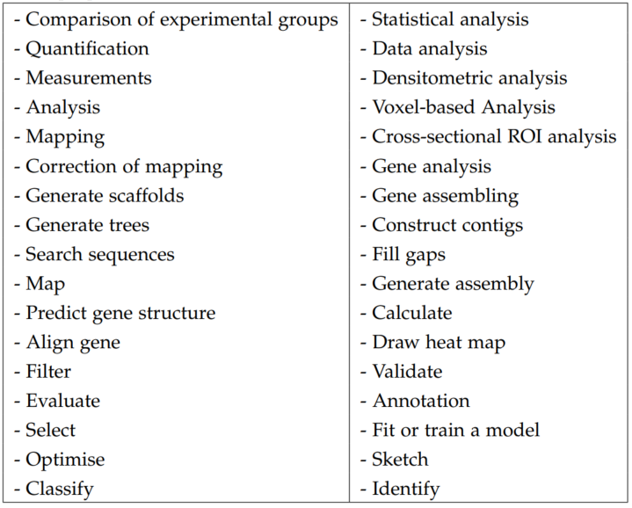
Identification of software usage purposes
Key words
(from the literature)
that reflect potential software usage purposes.
Intractable to manually analyze the whole SoMeSci Corpus.
Literature

Slide 11
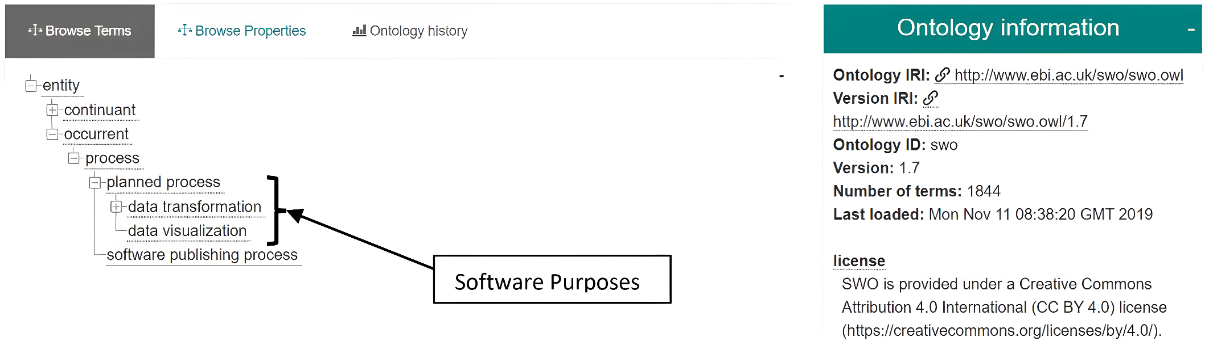
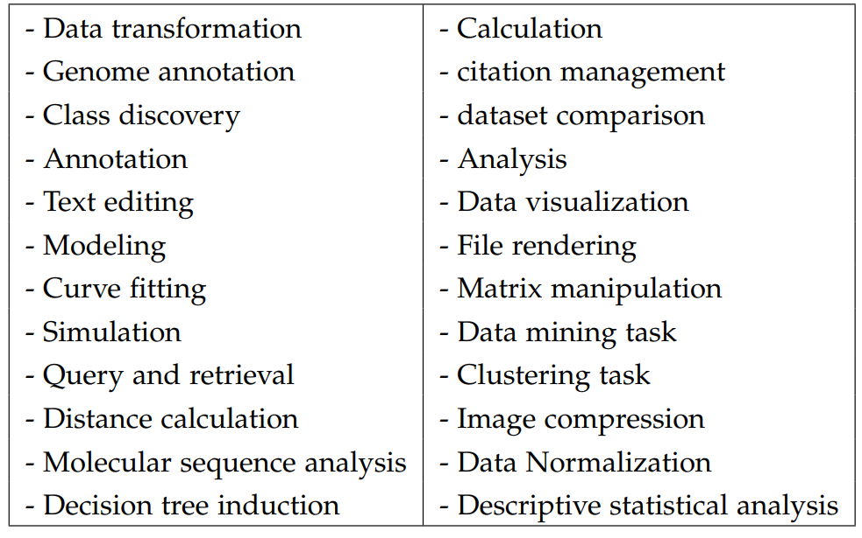
Identification of software usage purposes
The software ontology (SWO) – description of software for computational biology and informatics
SWO
(retrieval date 13-12-2021)

Slide 12
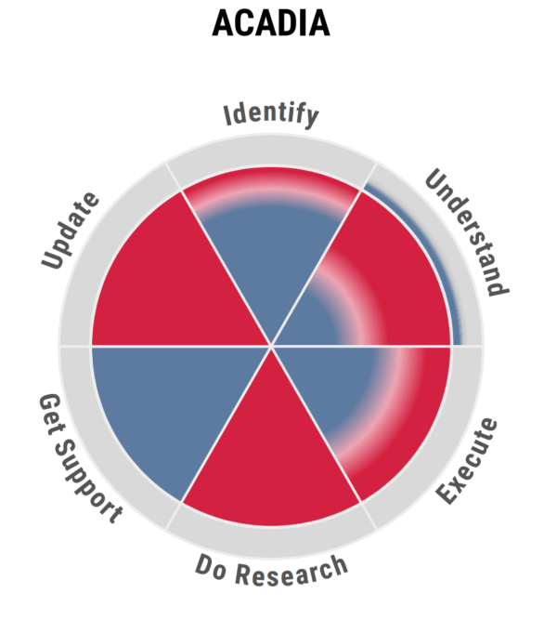
Identification of software usage purposes
Ontosoft– description of software for geo-science
Descriptions are 6-dimensional and in a pie-chart
Dimension | information
Identify | - Name of software, abbreviation
Understand | - Domain specific key words (~400)
Execute | - System requirements, license
Do Research | - Preferred citation
Get Support | - Contact details
Update | - version, maintenance, etc.

Slide 13
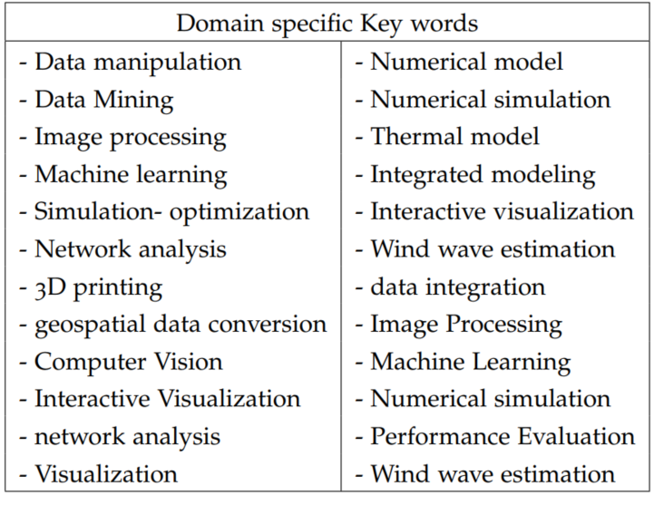
Identification of software usage purposes
OntoSoft
(retrieval date 13-12-2021)

Slide 14
Identification of software usage purposes
WikiData
a multi-lingual knowledge graph curated by Wikimedia community
no information about software purposes (as of today)
Available information is about software category
460 different software categories have been queried using Wikidata SPARQL terminal and have been analyzed using Gephi software

Slide 15
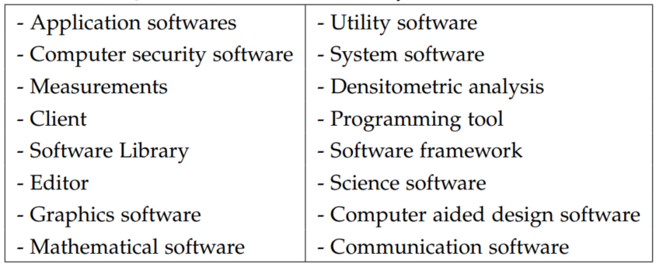
Identification of software usage purposes
WikiData

Slide 16
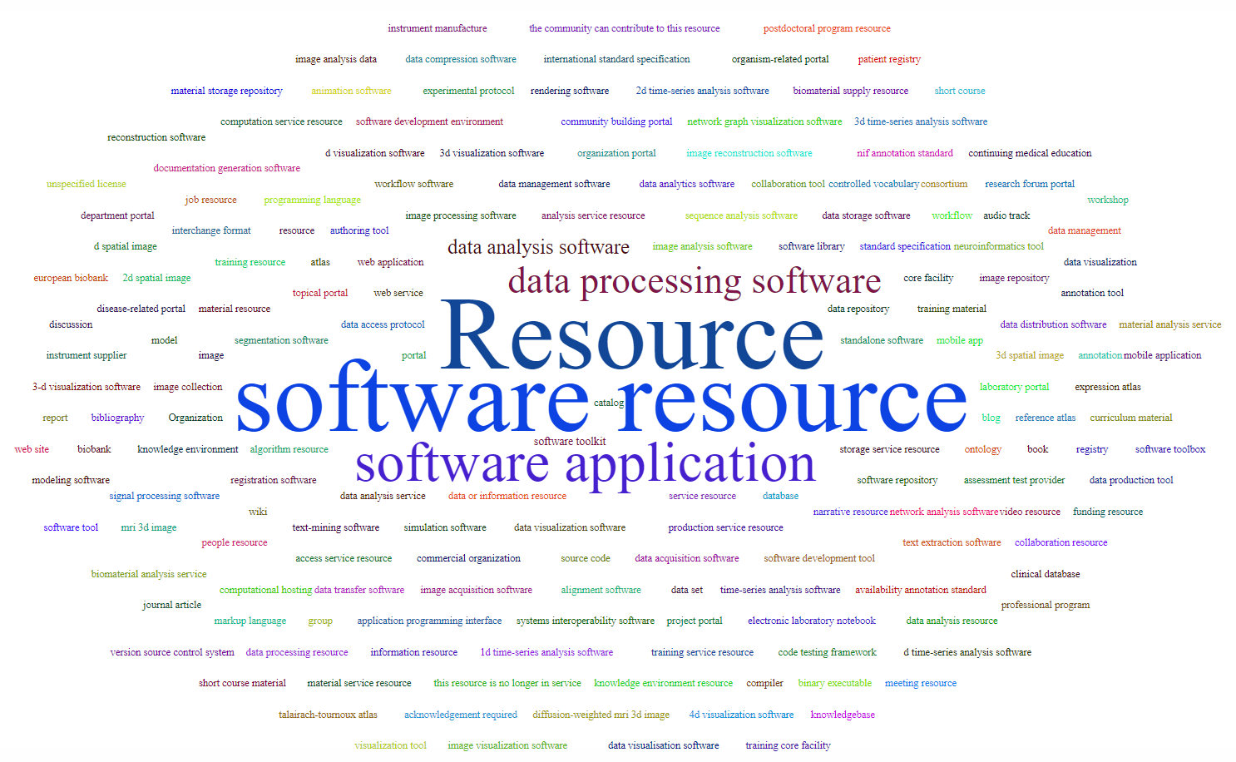
Identification of software usage purposes
Sci-Crunch Registry– 200 types of software tools

Slide 17
Identification of software usage purposes
Data Collection
Data Pre-Processing
Data Analysis
Data Visualization
Simulation
Stimulation
Modeling
Programming
Software purposes based on analysis of literature, software ontology(SWO), Ontosoft, WikiData, and Sci-Crunch

Slide 18
2. Annotation of Dataset with software purpose.
The Dataset
ANNOTATED with software purpose
SoMeSci article | Description
PLoS methods | 480 articles
PubMed full-text | 100 full-articles from PMC
PLoS sentences | 677 files that have software names mentioned in them
Creation sentences | 110 files that contain creation sentences (50 PMC, 60 PLoS)
Total | 1367 files
Annotation category | Types of annotations
Software-types (4) | Application, Plug-In, OS, PE
Mention-types (4) | Mention, Usage, Creation, Deposition
Additional-info (9) | Developer, Version, URL, Extension, Release, License, Abrv. & alt. name

Slide 19
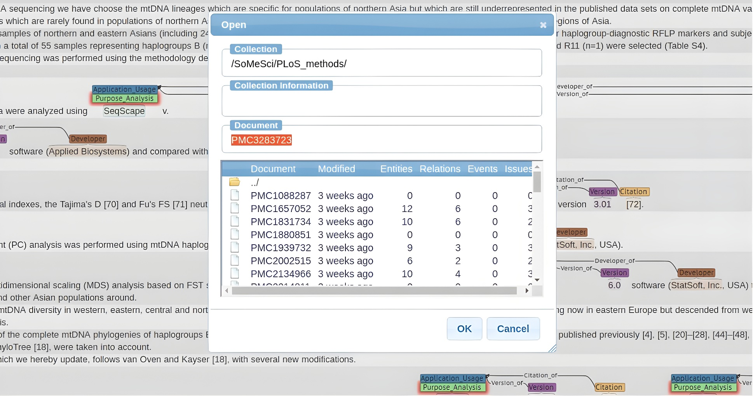
2. Annotation of Dataset with software purpose.
Annotation Tool: BRAT

Slide 20
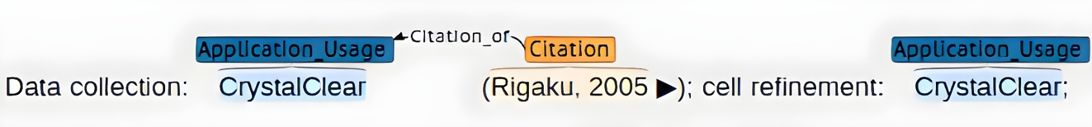
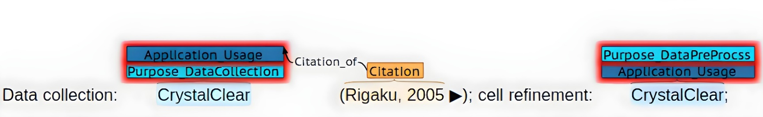
2. Annotation of Dataset with software purpose.
Annotation style: Top level annotation e.g. 3D modeling, mathematical modeling ➔ annotated as modeling

Slide 21
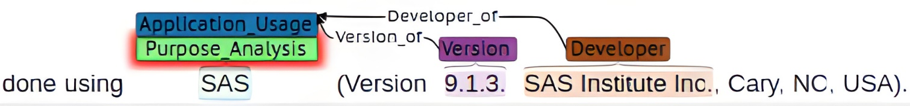
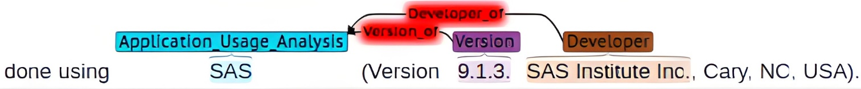
3. Pre-processing of Dataset
Automatic integrity testing ➔ removing unintended annotations
➔ adding missing annotations
Merging (Unifying) software purpose annotation with original (usage) annotation
Transformation to IOB format
Optimal Data splitting Train-Dev-Test (60-20-20), with ±5% for each class label

Slide 22
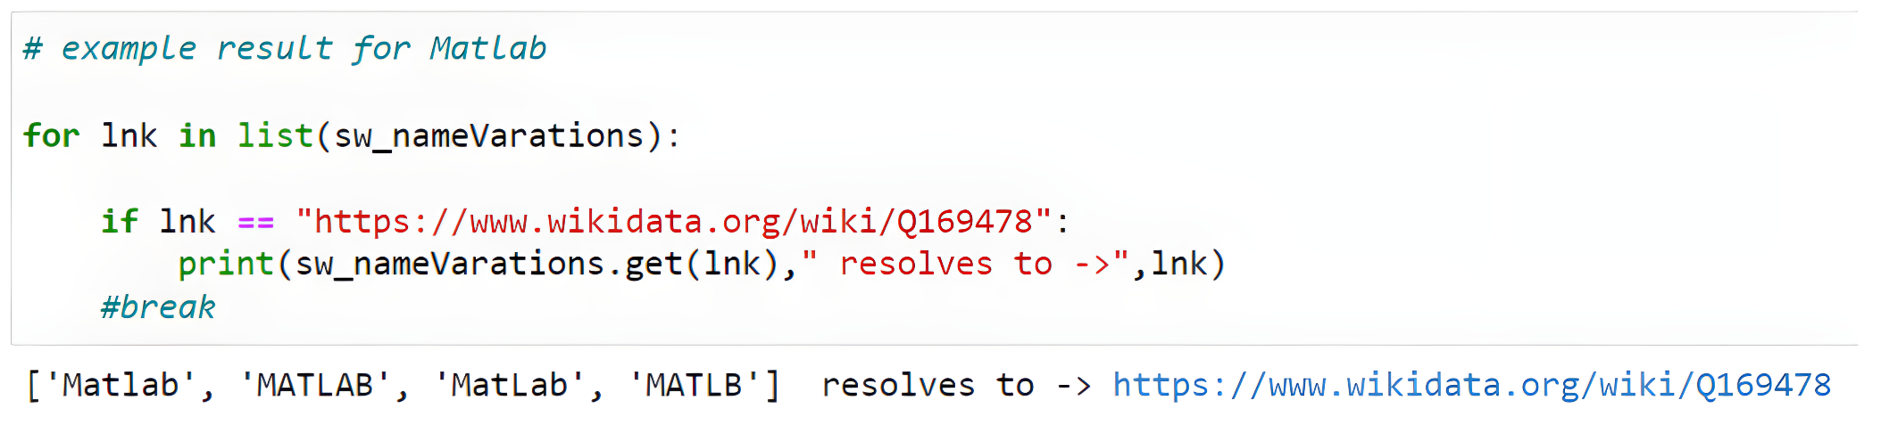
3. Pre-processing of Dataset
co-reference resolution of software entities

Slide 23
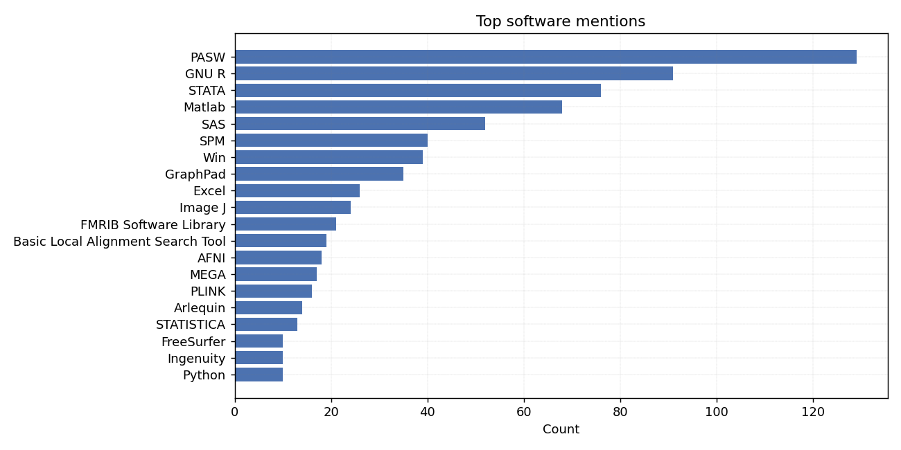
4. Analysis of Dataset

Slide 24
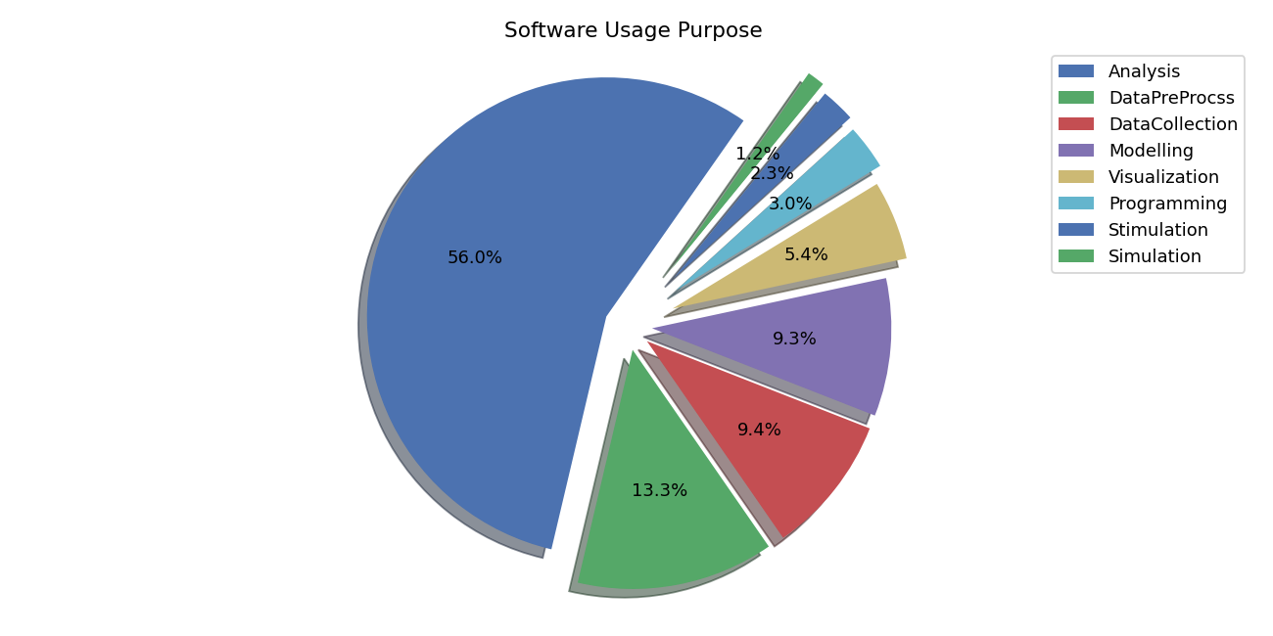
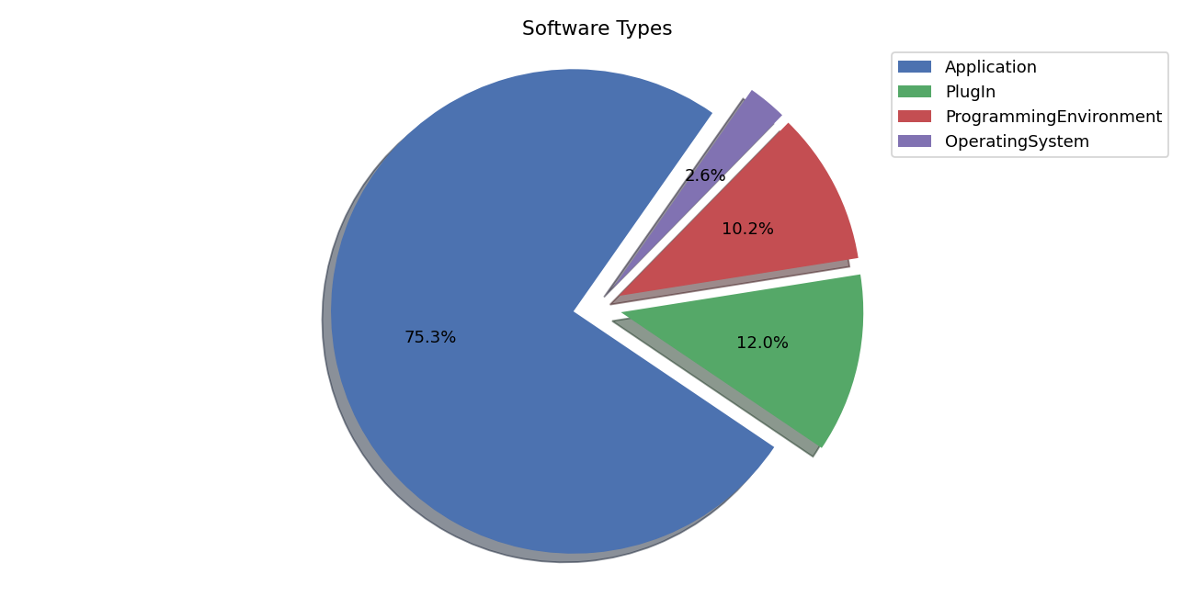
4. Analysis of Dataset

Slide 25
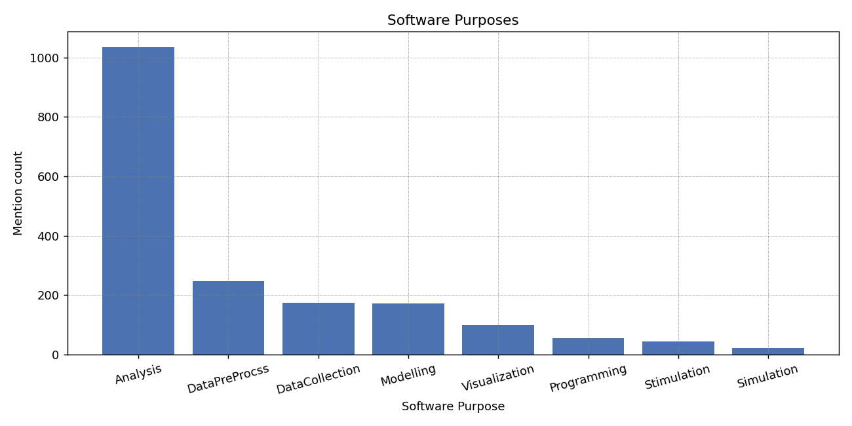
4. Analysis of Dataset

Slide 26
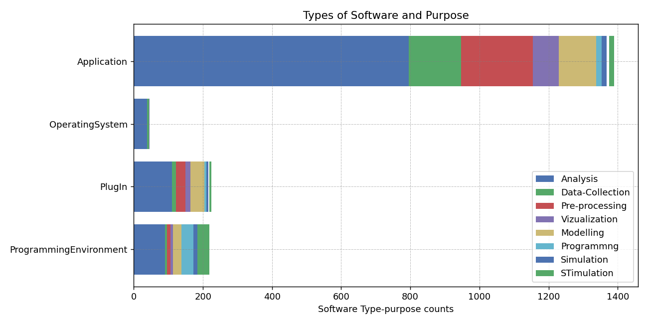
4. Analysis of Dataset

Slide 27
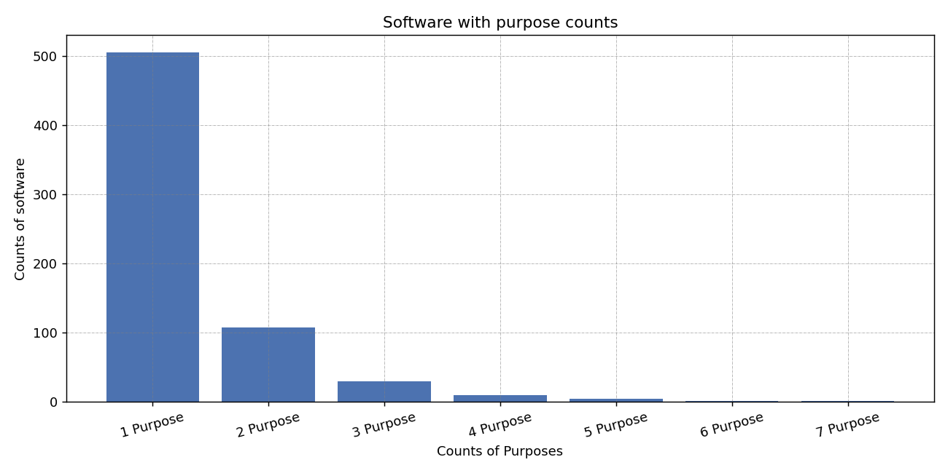
4. Analysis of Dataset

Slide 28
5. Classifier Model Selection
Software is a real-world entity, and the classification of software purposes is a NER problem
NER is one of classical Sequence labeling tasks among POS & Chunking
Two classes of sequence labeling models:
Classical ML Models
DL Models
HMM
MEMM
CRF
RNN
LSTM
Bi-LSTM
Bi-LSTM-CRF
Transformer Based Model
BERT
Bio-BERT
Sci-BERT

Slide 29
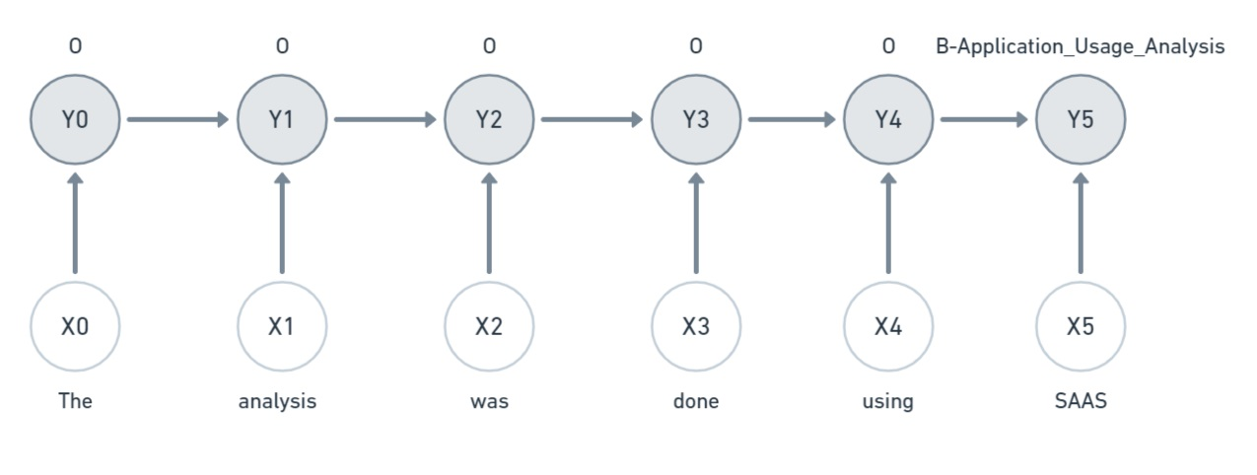
5. Classifier Model Selection
Hidden Markov Model

Slide 30
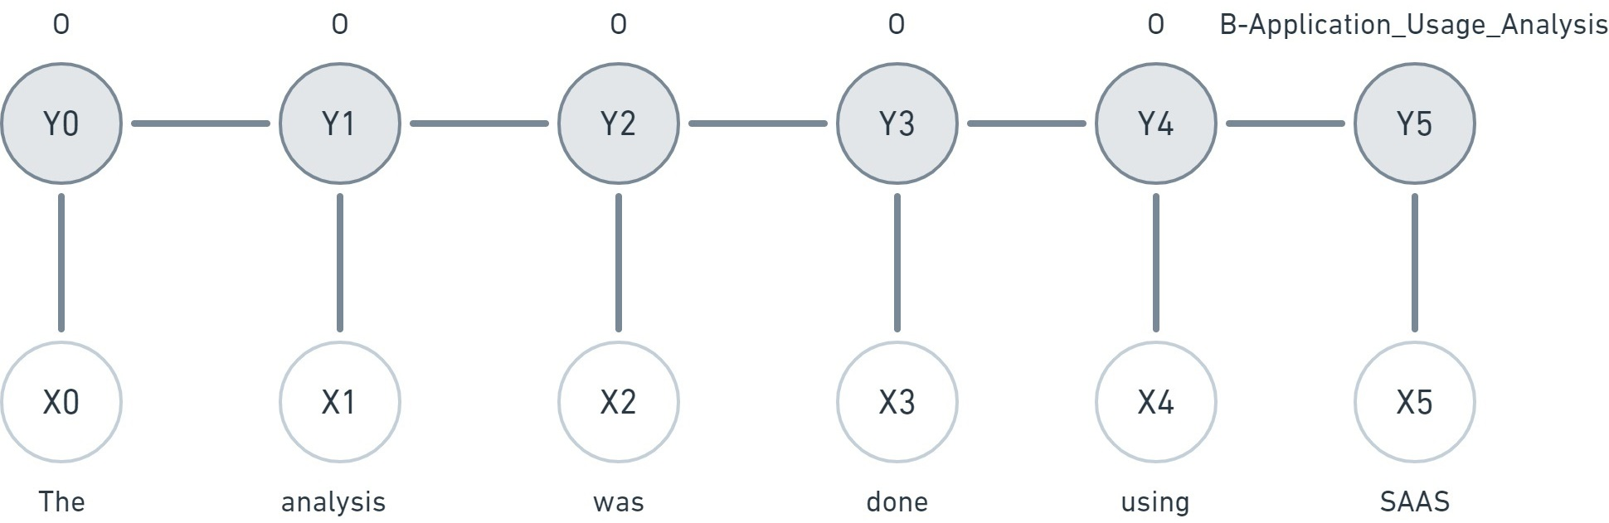
5. Classifier Model Selection
(Linear) Conditional Random Field

Slide 31
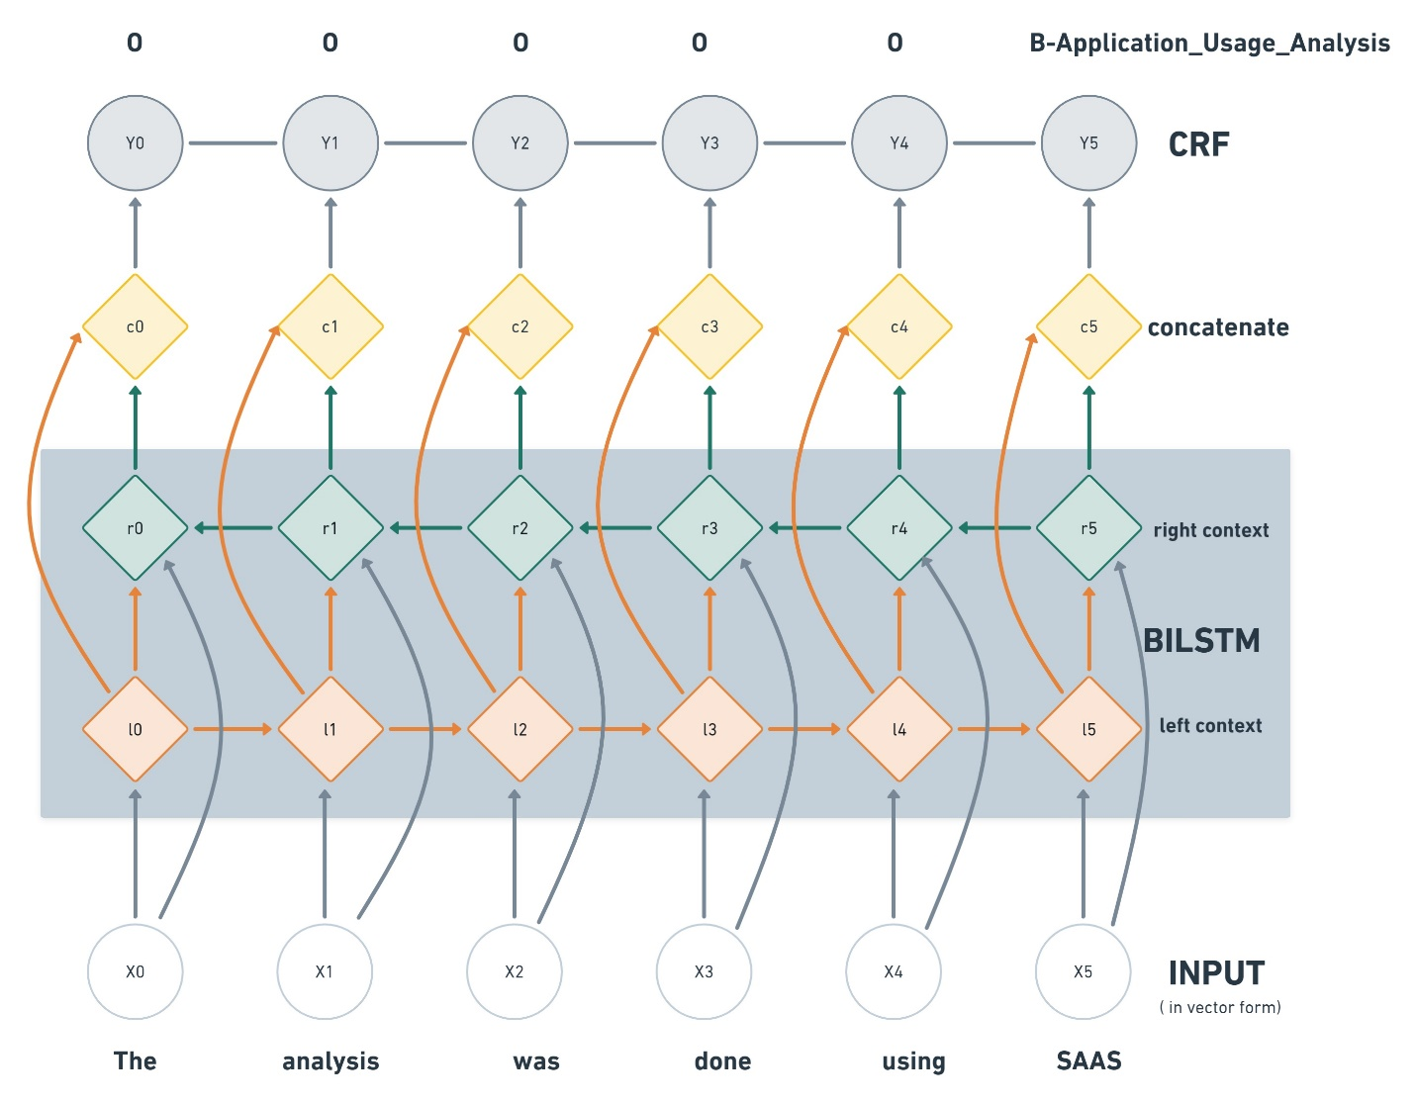
5. Classifier Model Selection
Bi-LSTM-CRF

Slide 32
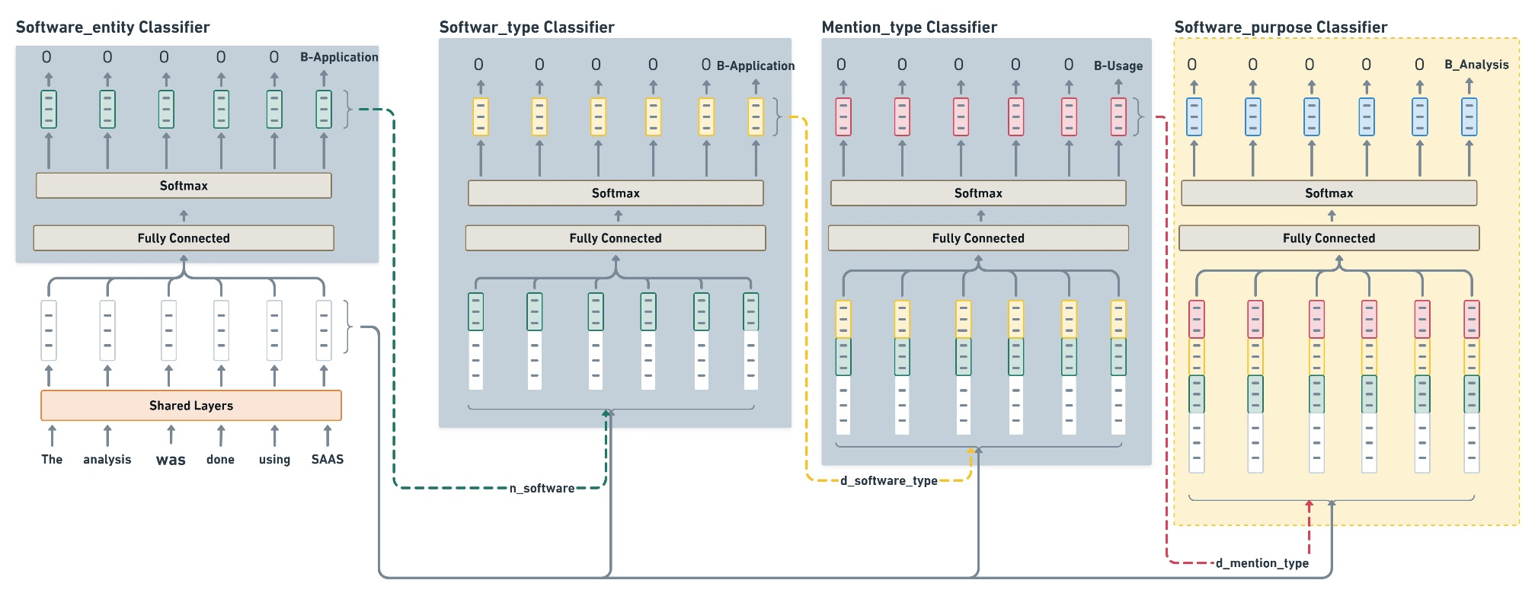
5. Classifier Model Selection
Deep Learning Models: BERT

Slide 33
6. Software purpose classification and evaluation
The impact of labeled data
The impact context
Left vs right context information
Context == whole paragraph
Context outside paragraph
Classification with 2-Cascade Sci-BERT
Bio-BERT vs Sci-BERT

Slide 34
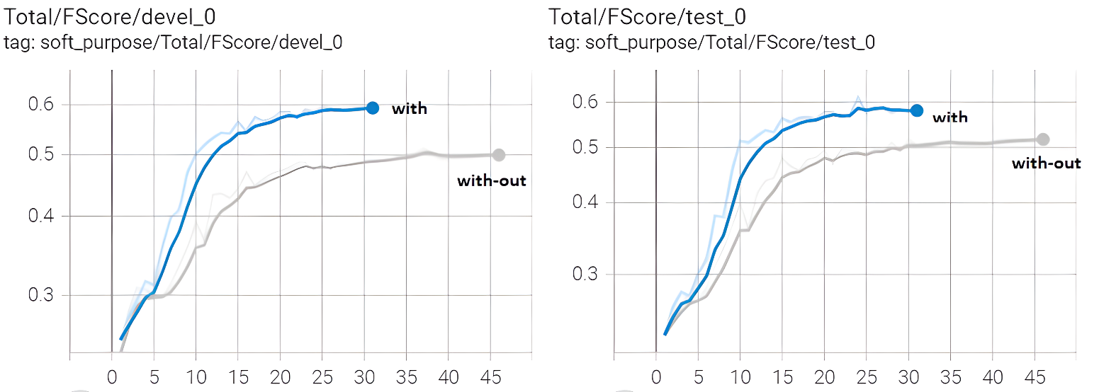
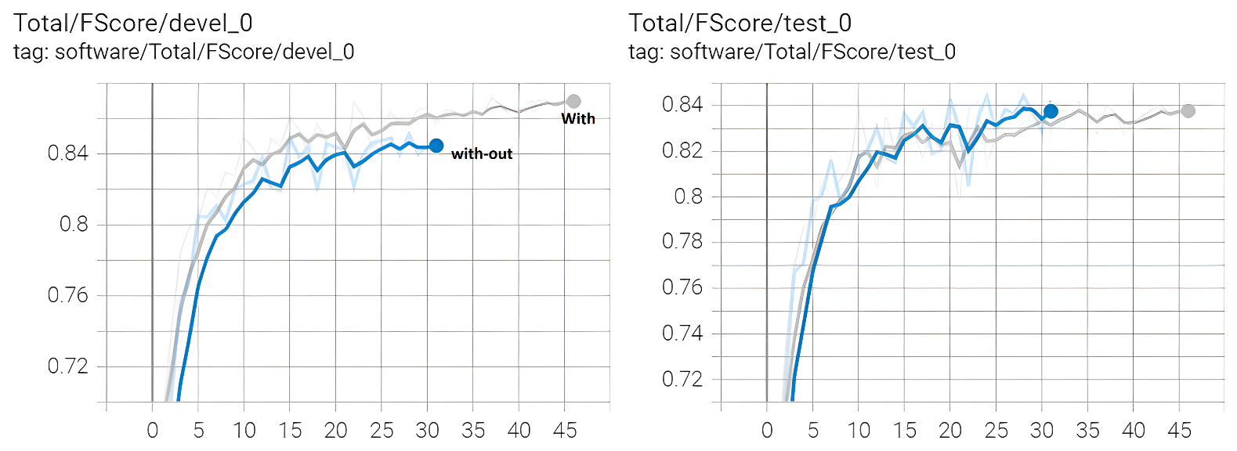
6. Software purpose classification and evaluation
The impact of labeled data

Slide 35
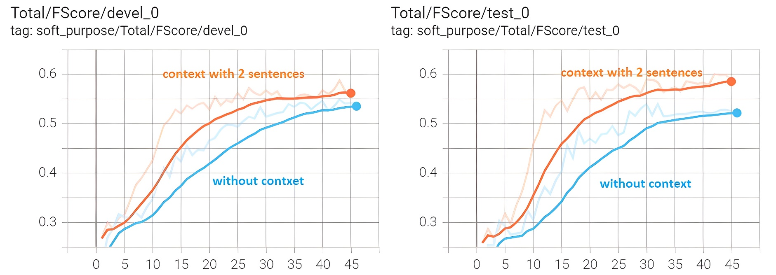
6. Software purpose classification and evaluation
The impact of larger context

Slide 36
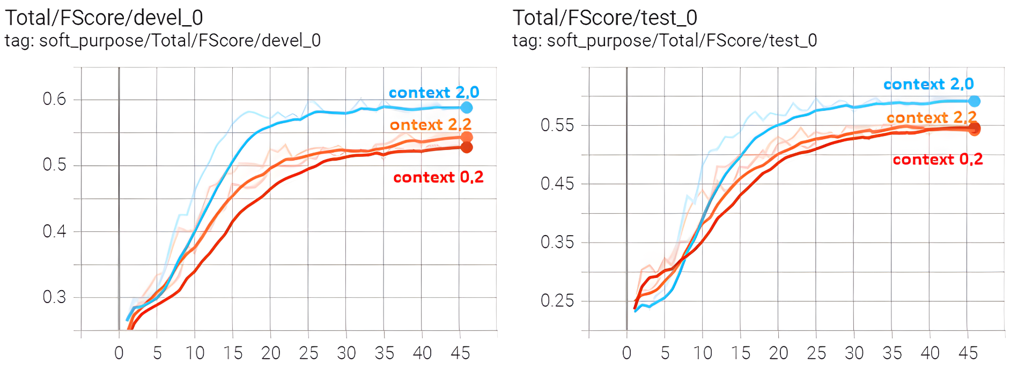
6. Software purpose classification and evaluation
Left-vs-Right Context

Slide 37
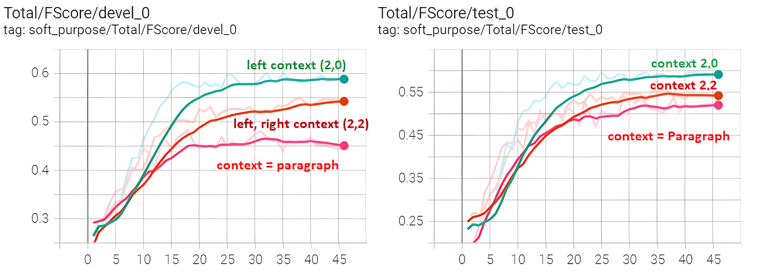
6. Software purpose classification and evaluation
Context == whole paragraph

Slide 38
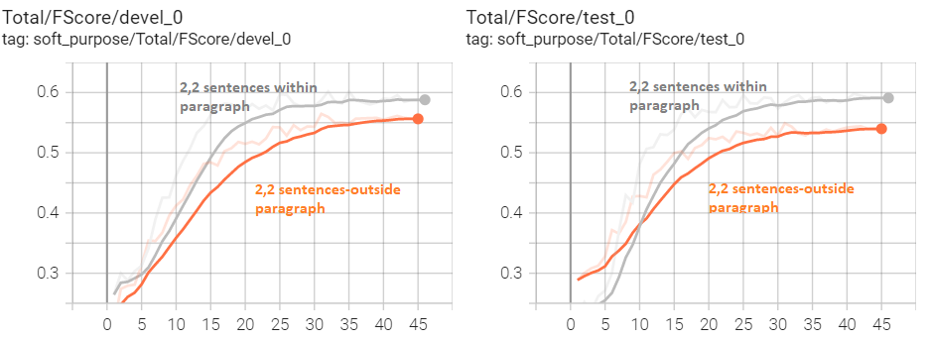
6. Software purpose classification and evaluation
Context == outside paragraph

Slide 39
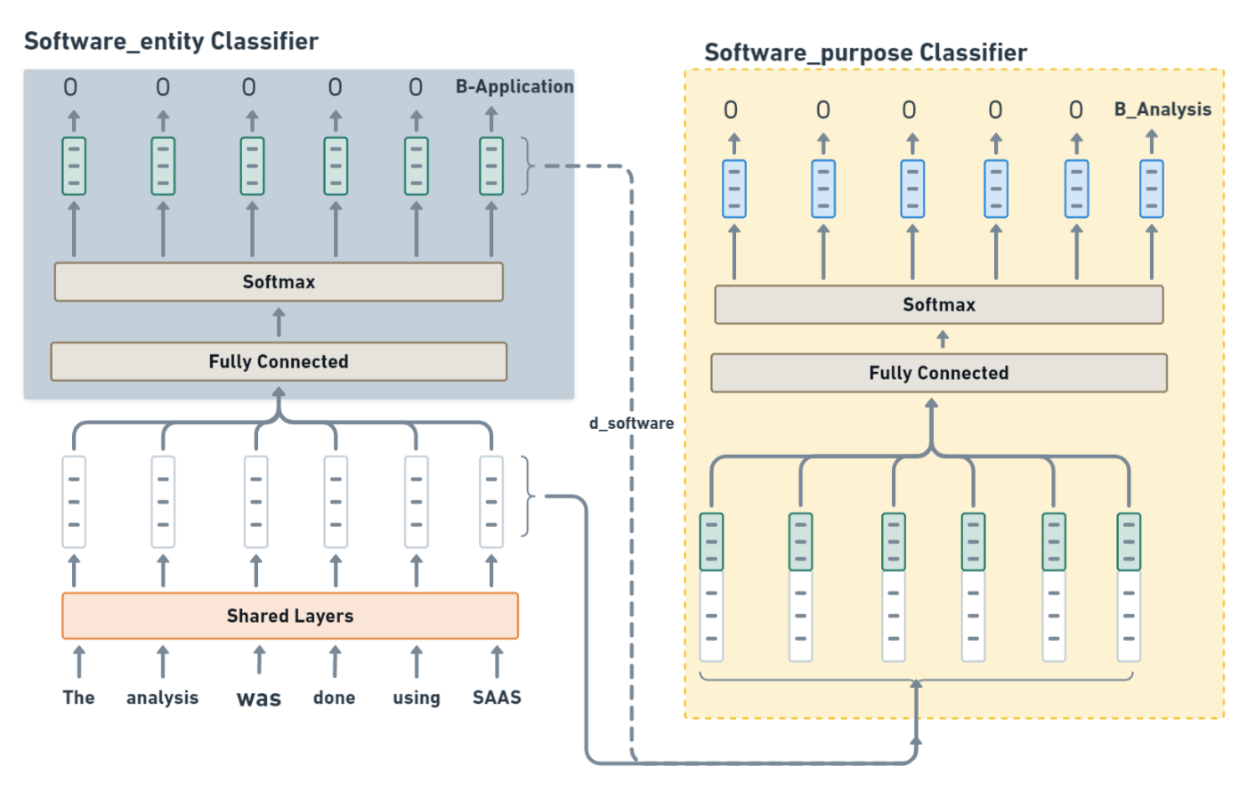
6. Software purpose classification and evaluation
Classification with 2-Cascade Sci-BERT

Slide 40
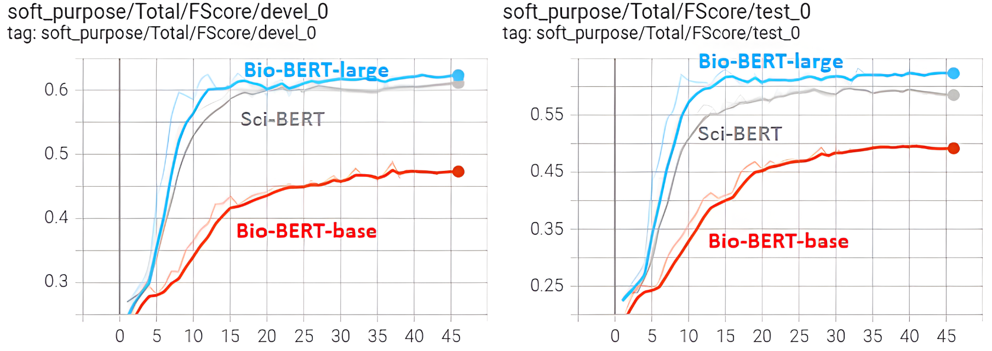
6. Software purpose classification and evaluation
Bio-BERT vs Sci-BERT

Slide 41
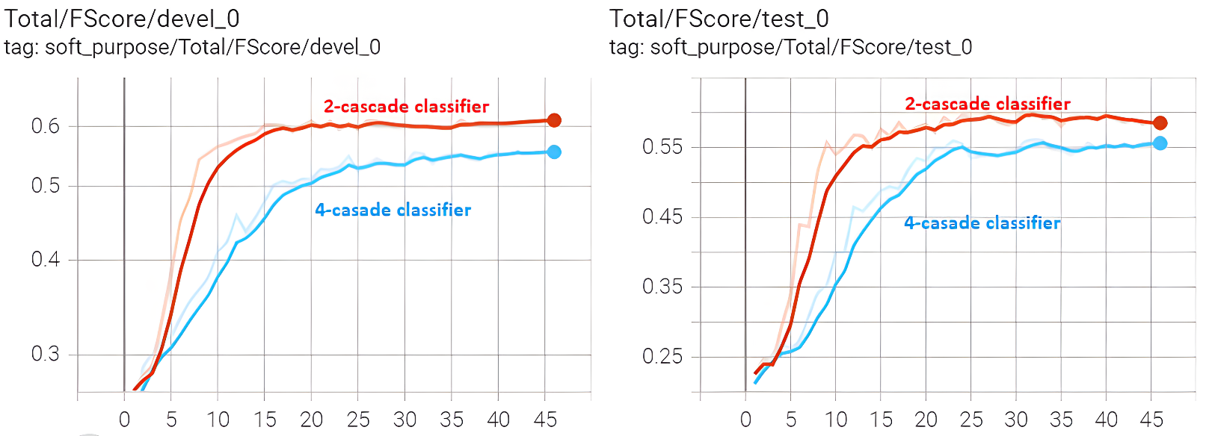
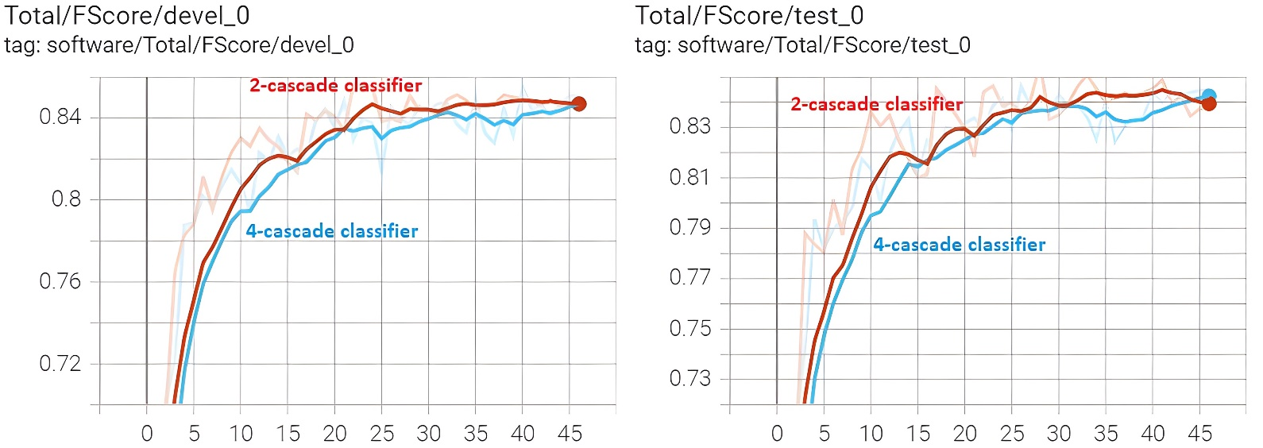
6. Software purpose classification and evaluation
Classification with 2-Cascade Sci-BERT

Slide 42
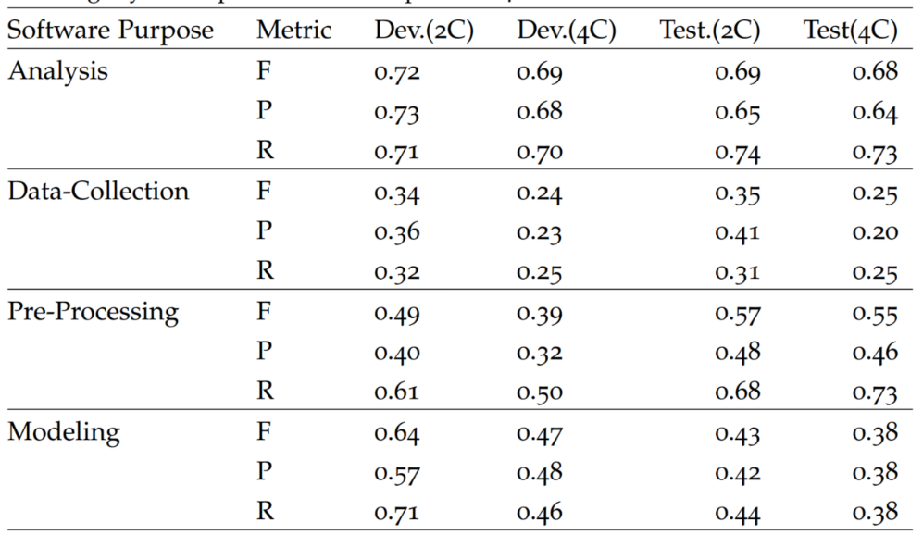
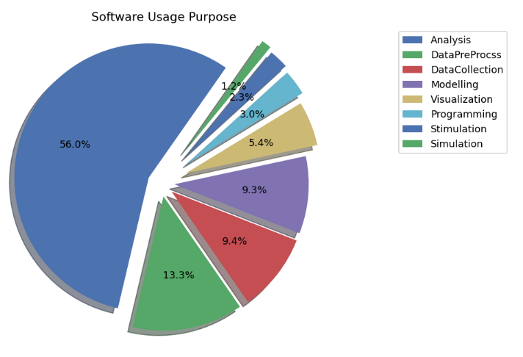
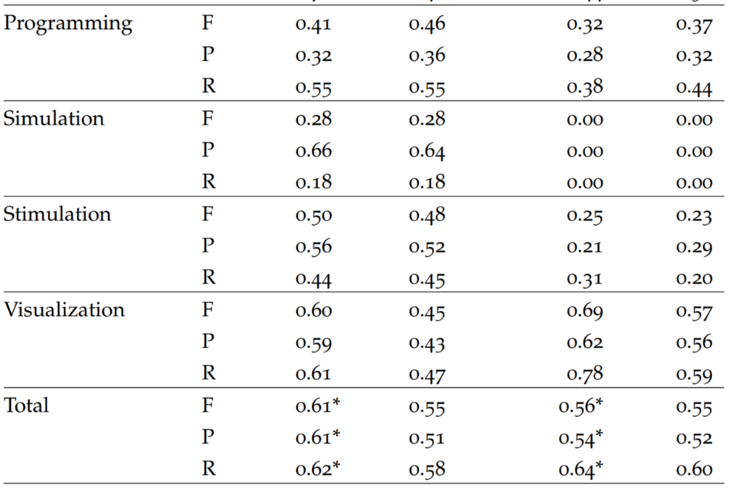
6. Software purpose classification and evaluation
Summary of classification performance 2C-Sci-BERT-Model

Slide 43
7. Conclusion and Future work
The role of software in scientific investigation is paramount.
Automatic classification of software usage purposes has been successful with a minimal set of annotated data set.
Various level of context affects classification performance. Two sentences from the left gives slightly better classification performance.
Unbounded context such as context as a whole paragraph or context outside a paragraph did not improve classification performance.
Classification with other variants of BERT model such as Bio-BERT-large gives a slightly better performance compared to Sci-BERT model, however it is slower.
Software purpose classification performance is greater for software purposes with larger number of class labels.

Slide 44
7. Conclusion and Future work
To increase classification performance, the remaining part of SoMeSci dataset can be annotated further and SoMeSci corpus size could also be increased.
Annotation of software usage purposes can also be done by domain experts.
Software tools that have similar purpose can be identified to cross-validate and compare results from various software tools.
Semantic browsing of scientific-articles can also be implemented based on a use of similar software for similar purpose.

Slide 45
Discussion

